Slide 1
Talk: Security
(Caesar)
By Hugo Lachkar

Slide 2
01
04
Create encryption in python (Caesar)
What is encryption?
02
05
Create decryption in python (Caesar)
What is Caesar code ?
03
06
Where do we use encryption ?
Real usage

Slide 3
01
What is encryption ?

Slide 4
Encryption
In cryptography, encryption is the process of encoding information.

Slide 5
02
What is Caesar Code?

Slide 6
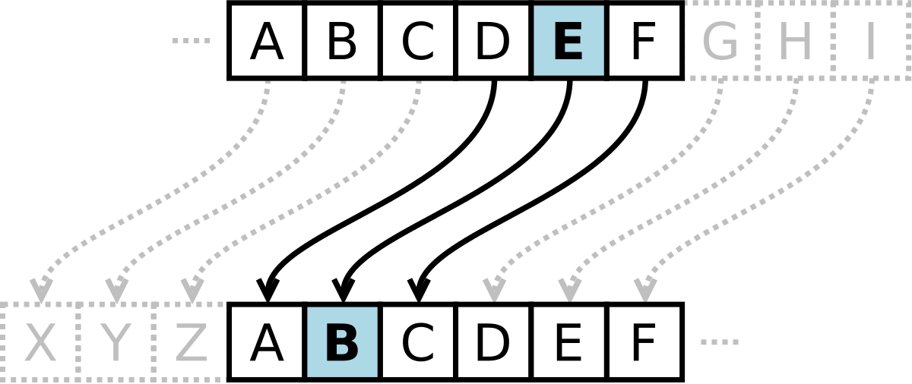
Caesar Code
Hello World -> Khoor Zruog

Slide 7
03
Where do we use encryption?

Slide 8
Money transaction
Public keys
Digital signatures

Slide 9
04
Create encryption in python

Slide 10
05
Create decryption in python

Slide 11
06
Real usage

Slide 12
Real usage
Hash
Hash
Hash
JS
Python
hash()
password_hash()
….
PHP
hashCode()
Bcrypt
…….
Hashlib
hash()
….

Slide 13
THANKS!
Do you have any questions?
hugo1.lachkar@epitech.eu
hugolachkar.com

